Slide 1
27장 (3) Spark 2 – Regression
2019. 1학기
Jeong Joon Lee

Slide 2
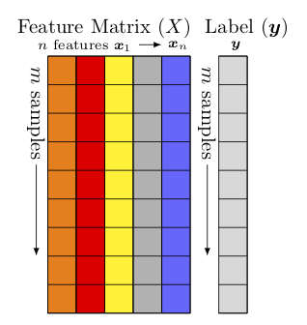
1. Simple Regression
Given data set
{ 𝑥𝑖1, . . . , 𝑥𝑖𝑛, 𝑦𝑖}_{𝑖=1}^{𝑚}
Matrix notaions
X = [𝑥1, · · · , 𝑥𝑛] with 𝑥𝑗 = {𝑥𝑖𝑗}_{𝑖=1}^{𝑚}, 𝑦 = {𝑦𝑖}_{𝑖=1}^{𝑚}
Formula
𝑦_{𝑖} = 𝛽₀ + 𝛽_{j}𝑥_{𝑖j} , where, 𝑖 = 1, · · · 𝑚, 𝑗 = 1, · · · 𝑛

Slide 3
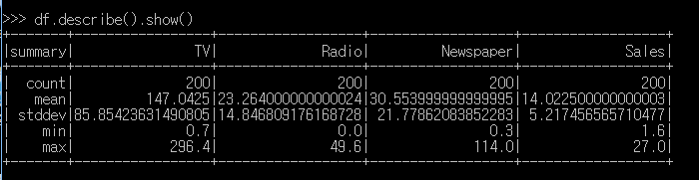
Pipelining demo program
# 1. Set up spark context and SparkSession
from pyspark.sql import SparkSession
spark = SparkSession \
.builder.appName("Python Spark regression example") \
.config("spark.some.config.option", "some-value") \
.getOrCreate()
# 2. Data Load
df = spark.read.format('com.databricks.spark.csv').\
options(header='true', inferschema='true').\
load(“c:/temp/Advertising.csv",header=True);
df.show(5,True)df
df.printSchema()
df.describe().show()

Slide 4
# 3. Convert the data to dense vector (features and label)
from pyspark.sql import Row
from pyspark.ml.linalg import Vectors
“””
# I provide two ways to build the features and labels
# method 1 (good for small feature):
def transData(row):
return Row(label=row["Sales"],features=Vectors.dense([row["TV"],
row["Radio"], row["Newspaper"]]))
“””
# Method 2 (good for large features):
def transData(data):
return data.rdd.map(lambda r: [Vectors.dense(r[:-1]),r[-1]]).toDF(['features','label'])
transformed= transData(df)
transformed.show(5)

Slide 5
(참고) 분포 확인 (skip)
def get_dummy(df,indexCol,categoricalCols,continuousCols,labelCol):
from pyspark.ml import Pipeline
from pyspark.ml.feature import StringIndexer, OneHotEncoder,VectorAssembler
from pyspark.sql.functions import col
indexers = [ StringIndexer(inputCol=c, outputCol="{0}_indexed".format(c)) for c in categoricalCols ]
# default setting: dropLast=True
encoders = [ OneHotEncoder(inputCol=indexer.getOutputCol(), \
outputCol="{0}_encoded".format(indexer. getOutputCol())) \
for indexer in indexers ]
assembler = VectorAssembler(inputCols=[encoder.getOutputCol() for encoder in encoders] \
+ continuousCols, outputCol="features")
pipeline = Pipeline(stages=indexers + encoders + [assembler])
model=pipeline.fit(df)
data = model.transform(df)
data = data.withColumn('label',col(labelCol))
return data.select(indexCol,'features','label')

Slide 6
# 5. Deal With Categorical Variables
from pyspark.ml import Pipeline
from pyspark.ml.regression import LinearRegression
from pyspark.ml.feature import VectorIndexer
from pyspark.ml.evaluation import RegressionEvaluator
# Automatically identify categorical features, and index them.
# We specify maxCategories so features with > 4 distinct values are treated as continuous.
featureIndexer = VectorIndexer(inputCol="features", outputCol="indexedFeatures",\
maxCategories=4).fit(transformed)
data = featureIndexer.transform(transformed)
data.show(5,True)
pyspark.ml.feature.VectorIndexer
https://spark.apache.org/docs/latest/ml-features.html#vectorindexer
It can both automatically decide which features are categorical and convert original values to category indices.
Take an input column of type Vector and a parameter maxCategories.
Decide which features should be categorical based on the number of distinct values, where features with at most maxCategories are declared categorical.
Compute 0-based category indices for each categorical feature.
Index categorical features and transform original feature values to indices.

Slide 7
# 6. Split the data into training and test sets (40% held out for testing)
(trainingData, testData) = transformed.randomSplit([0.6, 0.4])
# 7. Fit Ordinary Least Square Regression Model
# Import LinearRegression class
from pyspark.ml.regression import LinearRegression
# Define LinearRegression algorithm
lr = LinearRegression()
# 8. Pipeline Architecture
# Chain indexer and tree in a Pipeline
pipeline = Pipeline(stages=[featureIndexer, lr])
model = pipeline.fit(trainingData) # it returns LinearRegressionModel
Spark.ml.regression.LinearRegressionModel
https://spark.apache.org/docs/latest/api/java/org/apache/spark/ml/regression/LinearRegressionModel.html

Slide 8
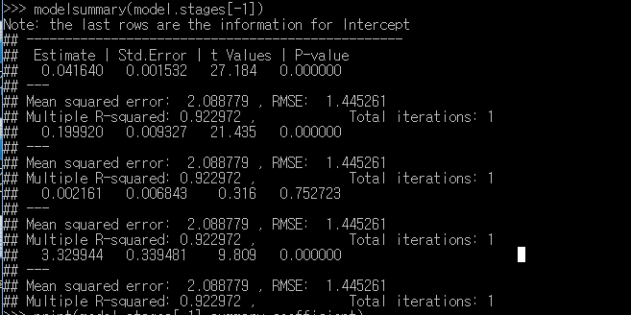
# 9. Summary of the Model
def modelsummary(model):
import numpy as np
print ("Note: the last rows are the information for Intercept")
print ("##","-------------------------------------------------")
print ("##"," Estimate | Std.Error | t Values | P-value")
coef = np.append(list(model.coefficients),model.intercept)
Summary=model.summary
for i in range(len(Summary.pValues)):
print ("##",'{:10.6f}'.format(coef[i]),\
'{:10.6f}'.format(Summary.coefficientStandardErrors[i]),\
'{:8.3f}'.format(Summary.tValues[i]),\
'{:10.6f}'.format(Summary.pValues[i]))
print ("##",'---')
print ("##","Mean squared error: % .6f" \
% Summary.meanSquaredError, ", RMSE: % .6f" \
% Summary.rootMeanSquaredError )
print ("##","Multiple R-squared: %f" % Summary.r2, ", \
Total iterations: %i"% Summary.totalIterations)
modelsummary(model.stages[-1])

Slide 9
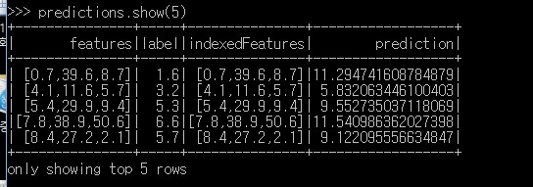
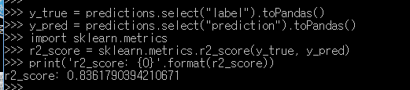
# 10. Make predictions
predictions = model.transform(testData)
# Select example rows to display.
predictions.show(5)
# 9. Evaluation
from pyspark.ml.evaluation import RegressionEvaluator
# Select (prediction, true label) and compute test error
evaluator = RegressionEvaluator(labelCol="label", predictionCol="prediction", metricName="rmse")
rmse = evaluator.evaluate(predictions)
print("Root Mean Squared Error (RMSE) on test data = %g" % rmse)
y_true = predictions.select("label").toPandas()
y_pred = predictions.select("prediction").toPandas()
import sklearn.metrics
r2_score = sklearn.metrics.r2_score(y_true, y_pred)
print('r2_score: {0}'.format(r2_score))

Slide 10
Q&A

